Slide 1


Investigation of dimensionality reduction methods for drug discovery data visualization
2017 Post Masters Placement Scheme (PMP):
Zhihan Xu (Cambridge Part III Student 2016-2017)
25/08/2017, Stevenage
Faculty of Mathematics / GSK Pharma R&D Platform Technology & Science
Notes:
Mention the name,
Personalize my background
Mathematical statistics in Part III
PhD in biostatistics in cambridge
Keep eye contact
The pace of speaking is good
Make presentation on the same laptop
My name, part iii

Slide 2

Outline
Part I: The motivation of my research internship
Part IIA: Introduction to dimensionality reduction methods
Part IIB: Implementation of methods on drug discovery data
Part IIC: My plan of the rest of my internship
Part III: The benefit of such Post Masters Placement Scheme (PMP)
Investigation of dimensionality reduction methods for drug discovery data visualization

Slide 3

Part I: The motivation of my research internship
My research internship
4 out of 8 weeks up to now
The motivation of my work
Vast amount of high dimensional drug discovery data
The complexity of various dimensionality reduction methods
Goal of my internship
Investigate and compare complex dimensionality reduction methods, using a drug-discovery example dataset.
Make the code available as tutorial suitable to scientists with limited mathematics background
Data scientists
Visualize
BigBig Medical Data
Investigation of dimensionality reduction methods for drug discovery data visualization
Notes:
This tutorial is suitable with data scientist with no pure mathematical background , but with some data processing knowledge

Slide 4
Part IIA: Introduction to dimensionality reduction methods
Summary of various dimensionality reduction methods
A list of various dimension reduction methods
Property of methods: parametric, parameters, computational, memory
Explore a selection of dimensionality reduction methods for data analysis
Signal decomposition: Principal Component Analysis (PCA)
Manifold learning: t-distributed stochastic neighbor embedding (t-SNE)
Investigation of dimensionality reduction methods for drug discovery data visualization

Slide 5
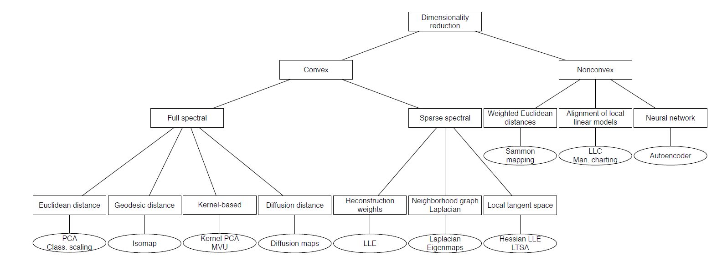
PART IIA: Summary of various dimensionality reduction methods
A list of various dimension reduction methods
PCA
LLE
The selection based on:
Informative Visualization of big data
Speed-up and improve performances of following prediction models
Reduction of the data storing cost
Isomap
Kernel PCA
Hessian LLE LTSA
Autoencoder
Laplacian Eigenmaps
LLC
Diffusion maps
Investigation of dimensionality reduction methods for drug discovery data visualization
Notes:
Talk more in informative visualization of big data,, visualisation!!!!!!!!!!!!!!!!!!!!!!!!!!!!

Slide 6
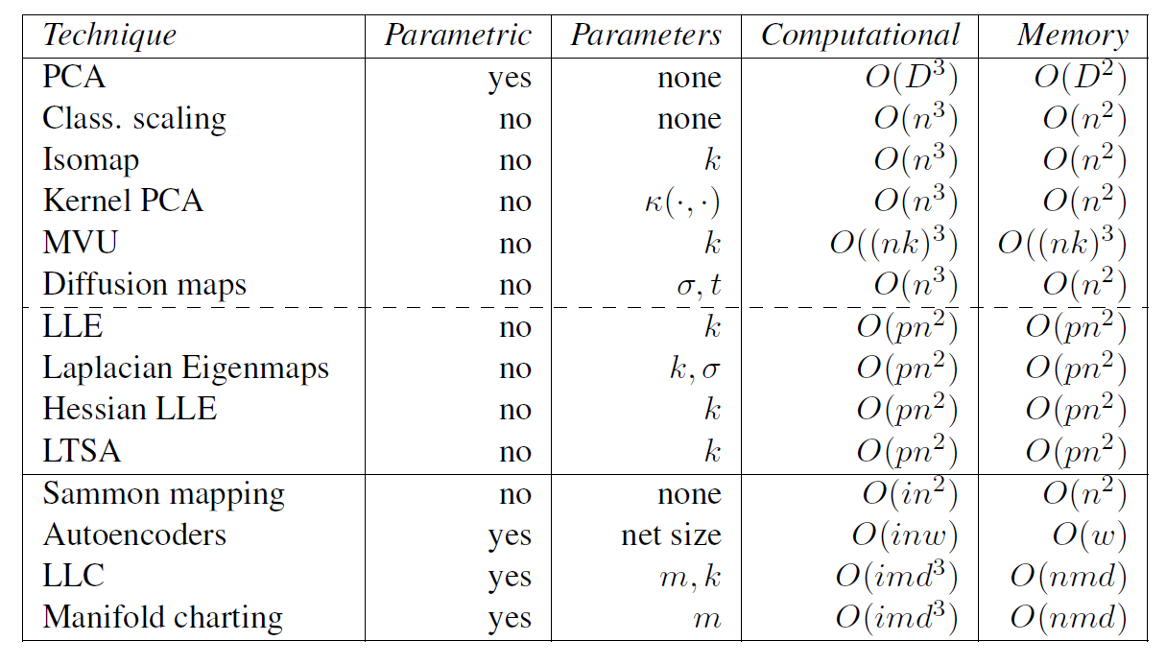
PART IIA: Summary of various dimensionality reduction methods
Property of methods: parametric, parameters, computational, memory
#Too far from an analysis for medical data
Investigation of dimensionality reduction methods for drug discovery data visualization
Notes:
Although some papers have summarize the properties of each method, but it is still too far from practical cases
Nightmare

Slide 7
Part IIA: Introduction to dimensionality reduction methods
Summary of various dimension reduction methods
A list of various dimension reduction methods
Characterization of methods: parametric, parameters, computational, memory
Explore a selection of dimensionality reduction methods for data analysis
Signal decomposition: Principal Component Analysis (PCA)
Manifold learning: t-distributed stochastic neighbor embedding (t-SNE)
Investigation of dimensionality reduction methods for drug discovery data visualization
Notes:
Clarify why I choose this two methods to talk more about the detail
Basic
Popular

Slide 8

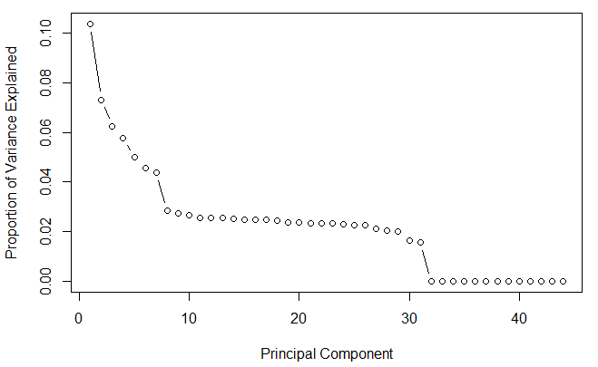
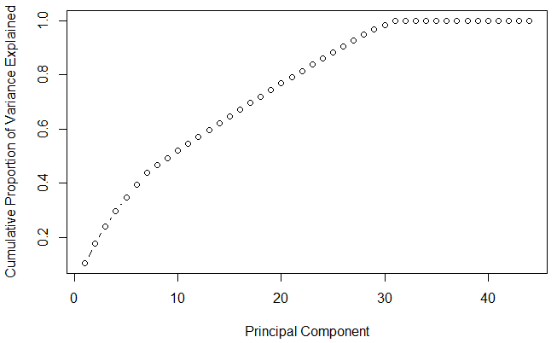
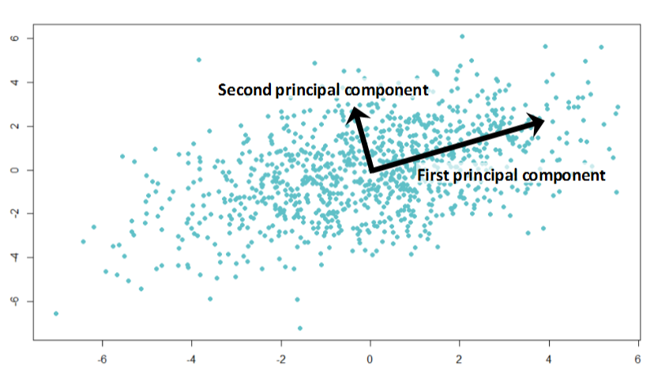
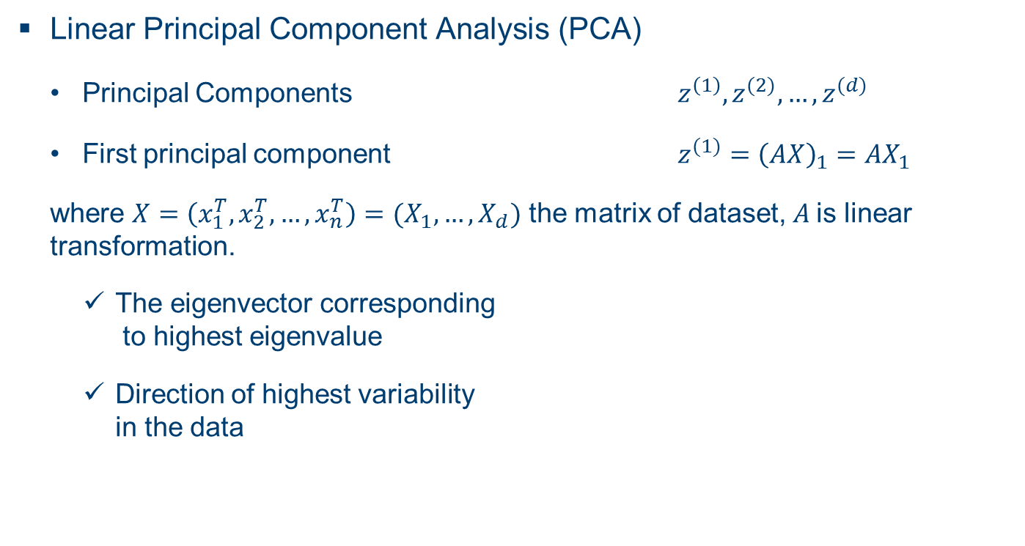
PART IIA: Explore a selection of dimensionality reduction methods for data analysis
Linear Principal Component Analysis (PCA)
Principal Components $z^{\left(1\right)},z^{(2)},…,z^{(d)}$
First principal component $z^{(1)}={\left(AX\right)}_{1}=AX_{1}$
where $X=\left(x_{1}^{T},x_{2}^{T},…,x_{n}^{T}\right)=(X_{1},…,X_{d})$ the matrix of dataset, $A$is linear transformation.
The eigenvector corresponding to highest eigenvalue
Direction of highest variability in the data
Case when only 3 genes are attached for each observation
Case when more than 40 genes attached for each observation
Investigation of dimensionality reduction methods for drug discovery data visualization
Notes:
PCA is used to overcome features redundancy in a data set.
These components aim to capture as much information as possible with high explained variance

Slide 9
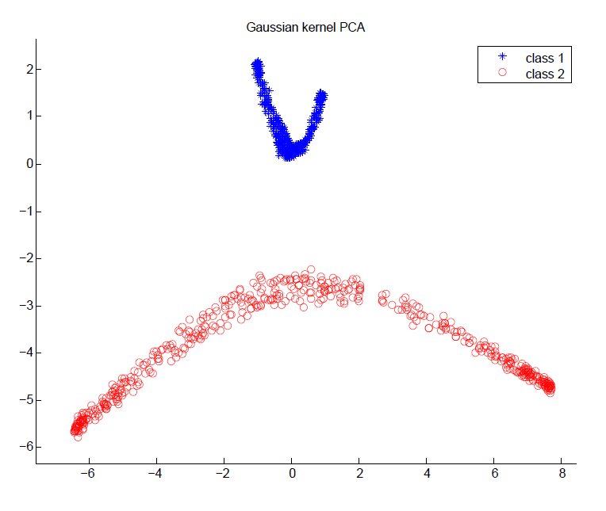
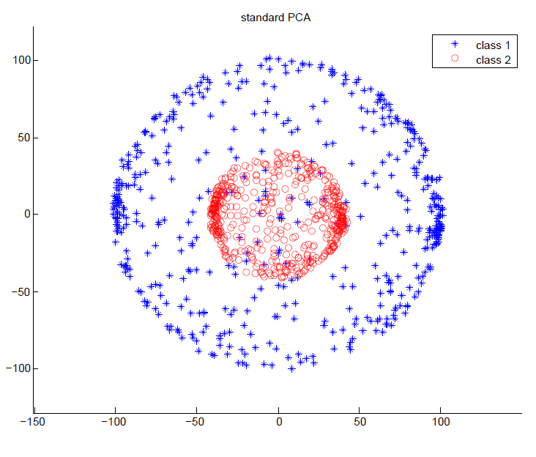

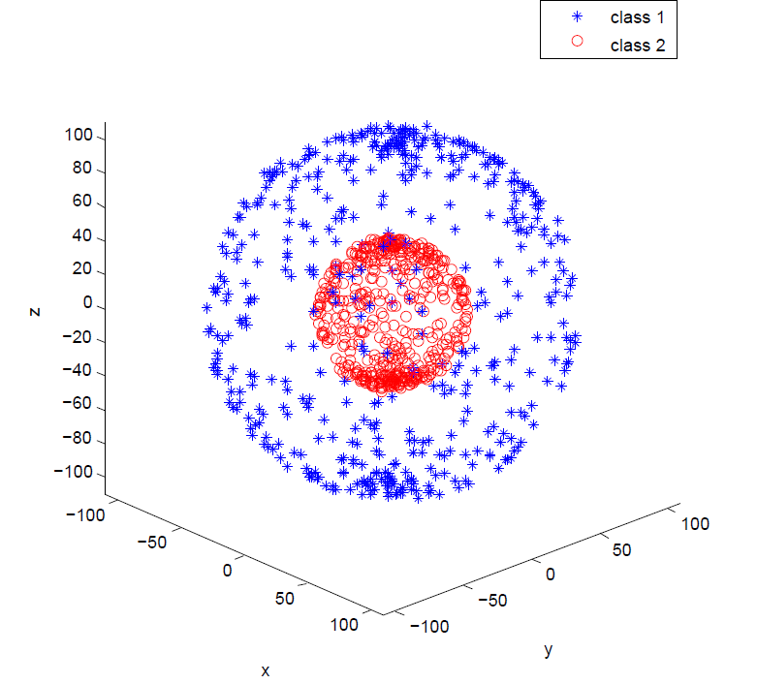
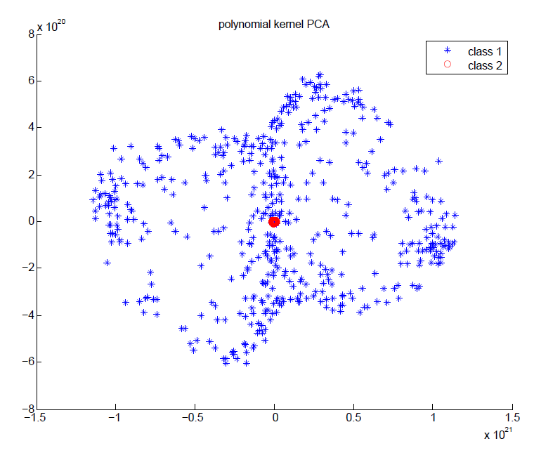
PART IIA: Explore a selection of dimensionality reduction methods for data analysis
Besides linear PCA, there are other extension of PCA that are not popular but really useful:
e.g. Kernel PCA, Sparse PCA, Incremental PCA
Linear
PCA
3D plot of two-concentric-spheres synthetic data
Polynomial PCA
Investigation of dimensionality reduction methods for drug discovery data visualization
Notes:
Kernel PCA, can do non-linearly separable dataset, it transform into a higher dimensional feature space which can be linearly separable

Slide 10
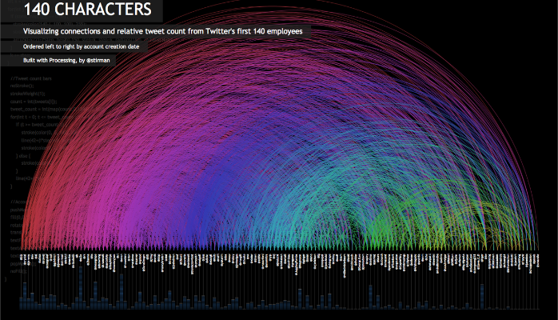
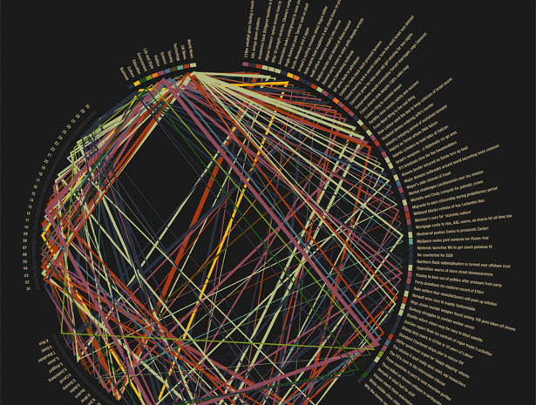
PART IIA: Explore a selection of dimensionality reduction methods for data analysis
T-Stochastic Neighbor Embedding (t-SNE)
based on probability distributions with random walk on neighbourhood graphs to find the structure within the data.
More advanced than PCA, similar data points are represented close together
non-linear dimensionality reduction algorithm suitable for visualization
Investigation of dimensionality reduction methods for drug discovery data visualization
Notes:
One type of manifold learning.
SNE starts by converting the high dimensional Euclidean distances between datapoints into conditional probabilities that represent similarities.
The similarity of datapoint x_j to datapoint x_i is the conditional probability

Slide 11
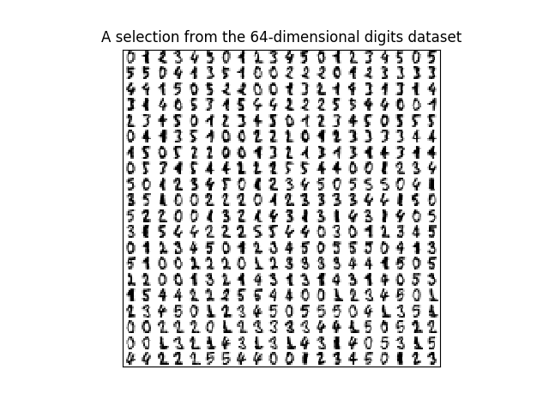
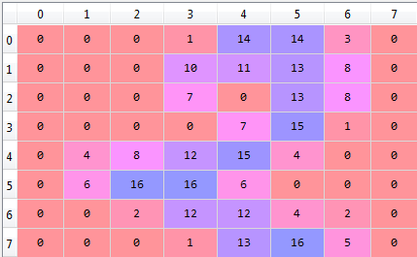
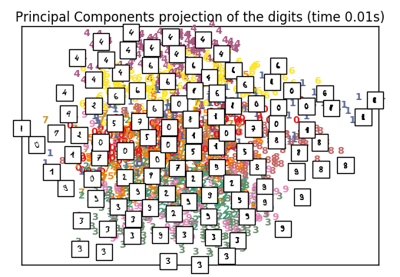
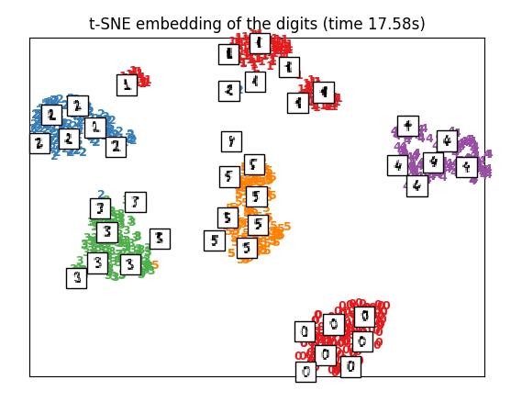
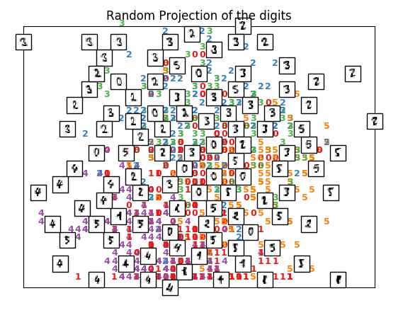

PART IIA: Explore a selection of dimensionality reduction methods for data analysis
Example: Handwritten digits classification
The comparison of performance of t-SNE and PCA
Time 0.01s
Time 17.58s
Input data: a $1084×64$ matrix
Investigation of dimensionality reduction methods for drug discovery data visualization
Notes:
Add on : why t-SNE is better
Why give better visualisation: add it on the slide, given the assumption of the methods
,Why PCA doesn’t work , e.g. linear method

Slide 12
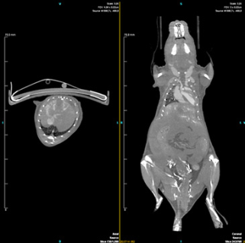
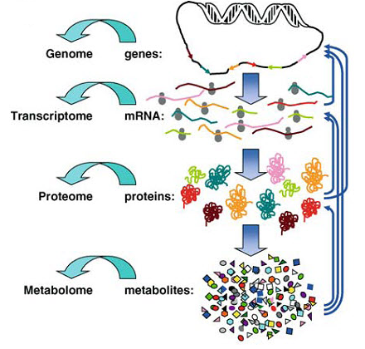
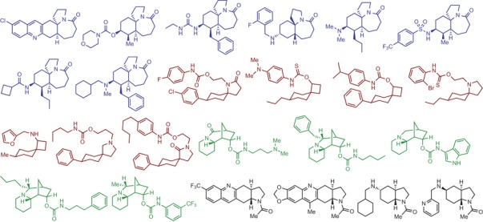
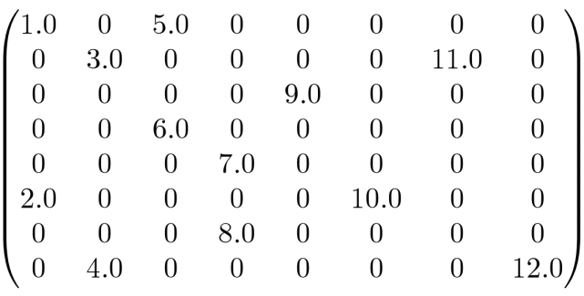
PART IIB: Familiar with the type of medical data we are analyzing
Drug discovery data
Omics
Physiochemical Properties of compounds
High dimensional
Sparse
complex
In vitro/in vivo experimental results
Parameters extracted from images
Investigation of dimensionality reduction methods for drug discovery data visualization
Notes:
Pronausation

Slide 13
PART IIB: Implementation of methods on drug discovery data
Familiar with the type of medical data we are analyzing
Drug discovery data
My task of data on the memory of treated Down Syndrome mice (mice data)
Principal Component Analysis (PCA) onto mice data
Definition
Performance onto mice data
t-distributed stochastic neighbor embedding (t-SNE) onto mice data
Definition
Performance onto mice data
Investigation of dimensionality reduction methods for drug discovery data visualization

Slide 14
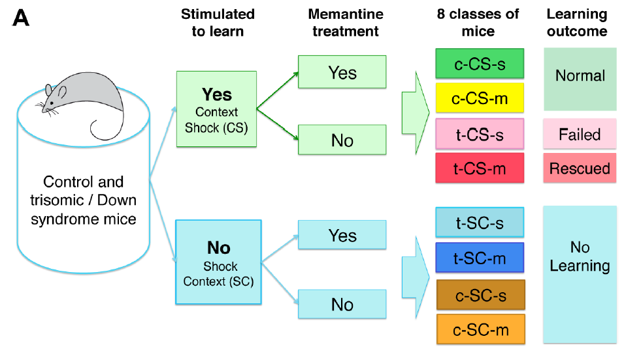
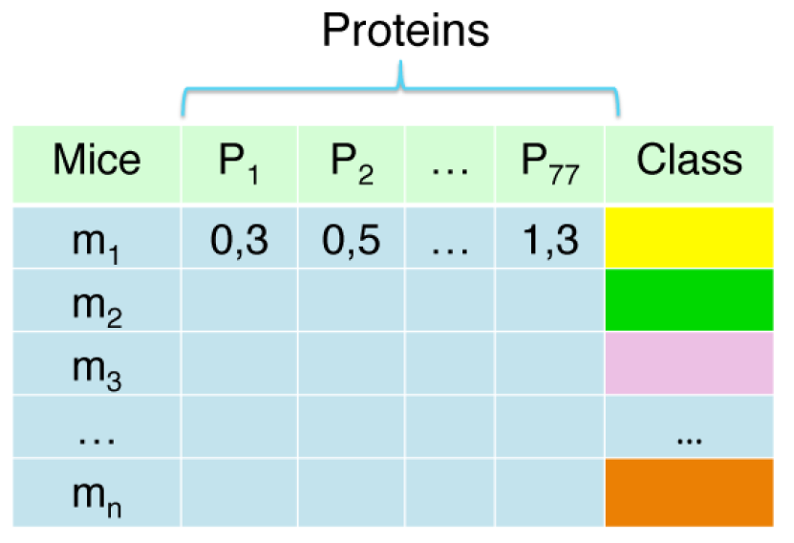
PART IIB: Familiar with the type of medical data we are analyzing
My task of data on the proteins of treated Down Syndrome mice
Two classes: no learning / stimulated to learn
Public available, previous publication has shown that the pattern of some proteins can differentiate the classes of mice
Good toy example to compare different dimensionality reduction methods, and show the result to scientists as a tutorial of data analysis
Investigation of dimensionality reduction methods for drug discovery data visualization
Notes:
My task of data on the memory of treated Down Syndrome mice
Down syndrome is a chromosomal abnormality associated with intellectual disability
Only take a subset of mice managing to learn after shock stimulation
Memantine/Saline treatment to rescue mice’s learning ability
Covariates: 77 protein expression data for each mice.
4 classes of mice: genotype (control and trisomy) and treatment (saline and memantine).
Learning outcome: Normal, Failed and Rescued.

Slide 15
PART IIB: Implementation of methods on drug discovery data
Familiar with the type of medical data we are analyzing
Drug discovery data
My task of data on the memory of treated Down Syndrome mice (mice data)
Principal Component Analysis (PCA) onto mice data
Definition
Performance onto mice data
t-distributed stochastic neighbor embedding (t-SNE) onto mice data
Definition
Performance onto mice data
Investigation of dimensionality reduction methods for drug discovery data visualization

Slide 16

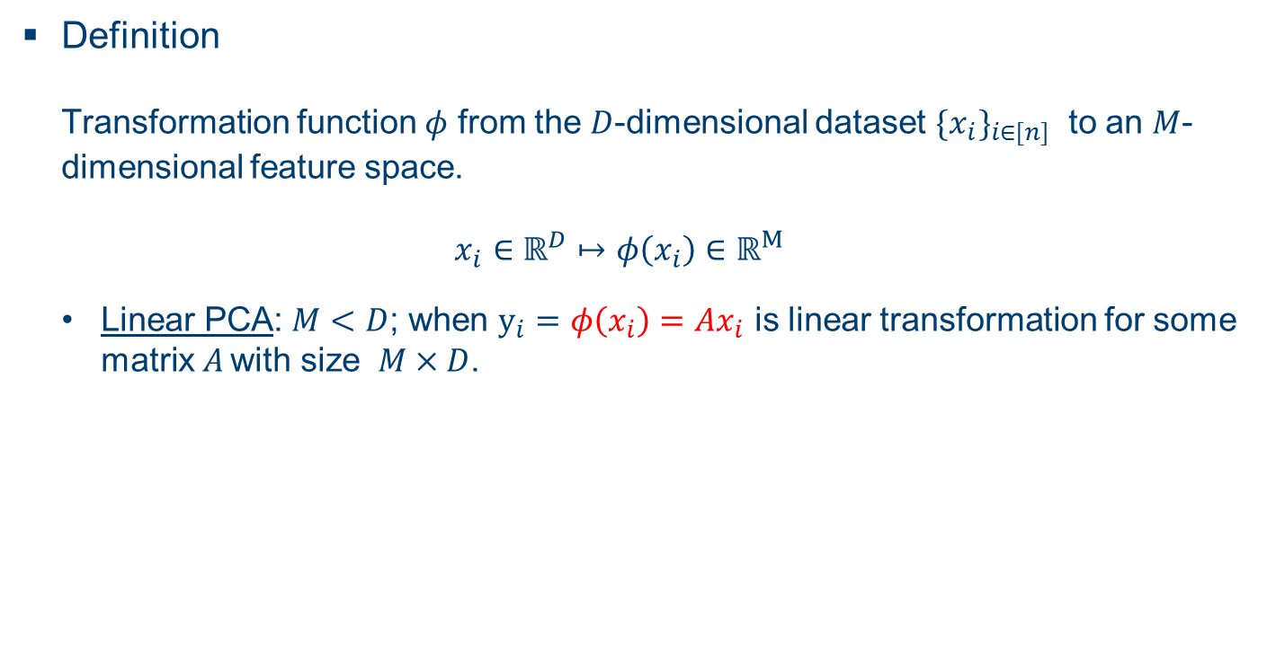
PART IIB: Principal Component Analysis (PCA) onto mice data
Definition Transformation function $φ$ from the $D$-dimensional dataset ${{\{x}_{i}\}}_{i∈[n]}$ to an $M$-dimensional feature space. $x_{i}∈ℝ^{D}↦φ\left(x_{i}\right)∈ℝ^{M}$
Linear PCA: $M<D$; when $y_{i}=φ\left(x_{i}\right)=Ax_{i}$ is linear transformation for some matrix$A$ with size $M×D$.
Investigation of dimensionality reduction methods for drug discovery data visualization
Notes:
No requirement to know the explicit form of \phi, only needed in dot productes

Slide 17
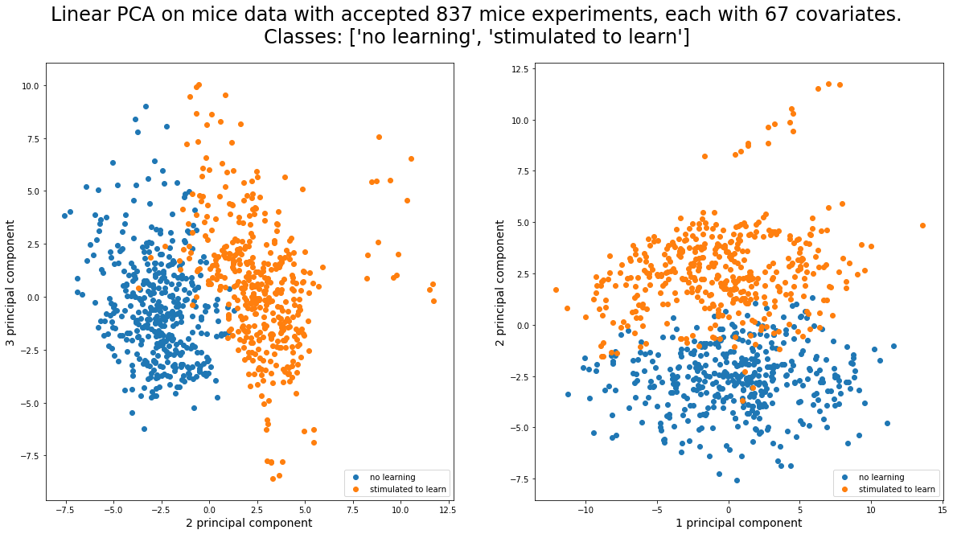
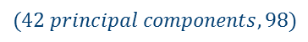
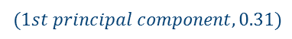
PART IIB: Principal Component Analysis (PCA) onto mice data
Performance onto mice data (Linear PCA)
Linear PCA onto mice data
The contributing variance of principal components
$$(1st principal component, 0.31)$$
$$(42 principal components,98)$$
Investigation of dimensionality reduction methods for drug discovery data visualization

Slide 18
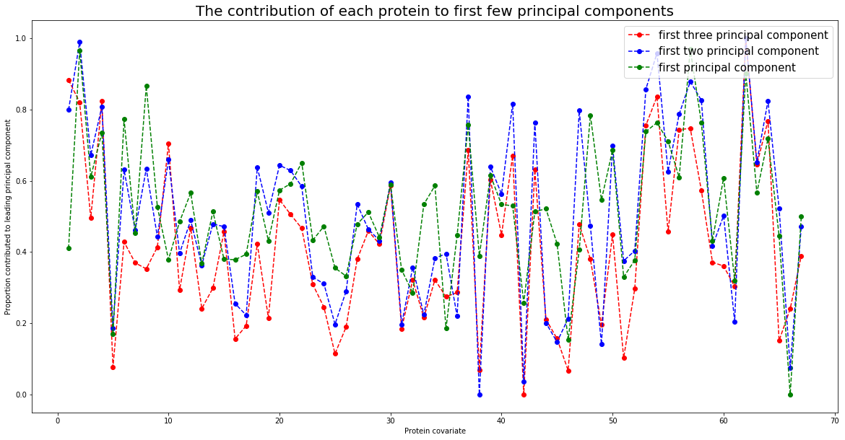
PART IIB: Principal Component Analysis (PCA) onto mice data
Performance onto mice data (Linear PCA)
Interpretation of the most influencing proteins
Most influencing protein | 1st protein | 2nd protein | 3rd protein
First principal component | IL1B_N | BDNF_N | Ubiquitin_N
First two PC | Ubiquitin_N | BDNF_N | GFAP_N
First three PC | Ubiquitin_N | ITSN1_N | GFAP_N
Investigation of dimensionality reduction methods for drug discovery data visualization

Slide 19
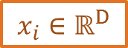
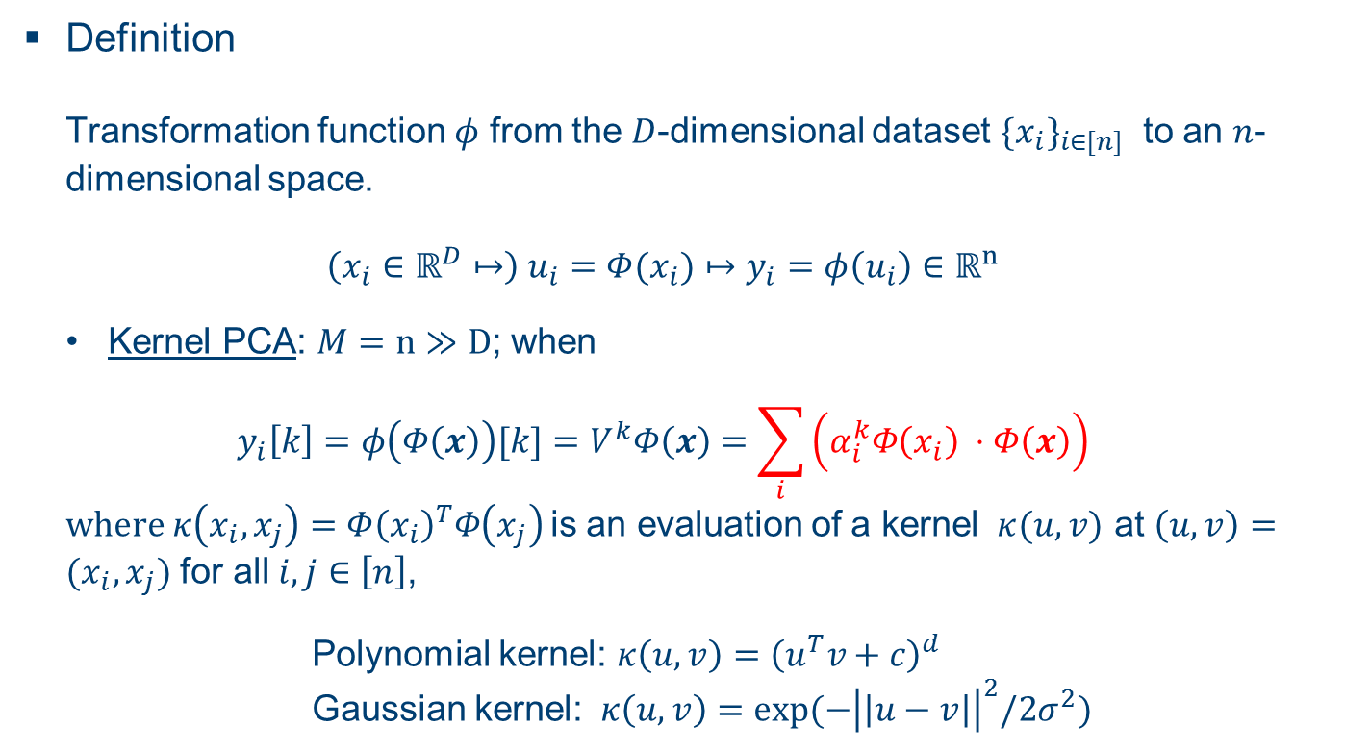
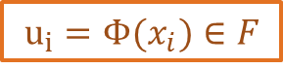
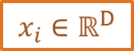
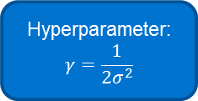
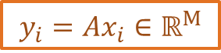

PART IIB: Principal Component Analysis (PCA) onto mice data
Definition Transformation function $φ$ from the $D$-dimensional dataset ${{\{x}_{i}\}}_{i∈[n]}$ to an $n$-dimensional space. $\left(x_{i}∈ℝ^{D}↦\right) u_{i}={Φ(x}_{i})↦y_{i}=φ\left(u_{i}\right)∈ℝ^{n}$
Kernel PCA: $M=n≫D$; when
$$y_{i}\left[k\right]=φ\left(Φ\left(x\right)\right)[k]=V^{k}Φ\left(x\right)=\sum_{i}{\left(α_{i}^{k}Φ\left(x_{i}\right) ⋅Φ\left(x\right)\right)}$$ $where κ\left(x_{i},x_{j}\right)=Φ{\left(x_{i}\right)}^{T}Φ\left(x_{j}\right)$is an evaluation of a kernel $κ(u,v)$ at $\left(u,v\right)=(x_{i},x_{j})$ for all $i,j∈\left[n\right]$,
Polynomial kernel: $κ\left(u,v\right)={\left(u^{T}v+c\right)}^{d}$ Gaussian kernel: $κ\left(u,v\right)=\exp{(−{\left|\left|u−v\right|\right|}^{2}/2σ^{2})}$
Original
Space
Feature
Space
Projected
Space
Linear PCA
$$x_{i}∈ℝ^{D}$$
$$y_{i}=Ax_{i}∈ℝ^{M}$$
Kernel PCA
$$x_{i}∈ℝ^{D}$$
$${u_{i}=Φ(x}_{i})∈F$$
$$y_{i}=Vu_{i}∈ℝ^{n}$$
Using kernel trick
Hyperparameter:
$$γ=\frac{1}{2σ^{2}}$$
Investigation of dimensionality reduction methods for drug discovery data visualization
Notes:
No requirement to know the explicit form of \phi, only needed in dot productes
Kernel PCA is not good for visualisation

Slide 20
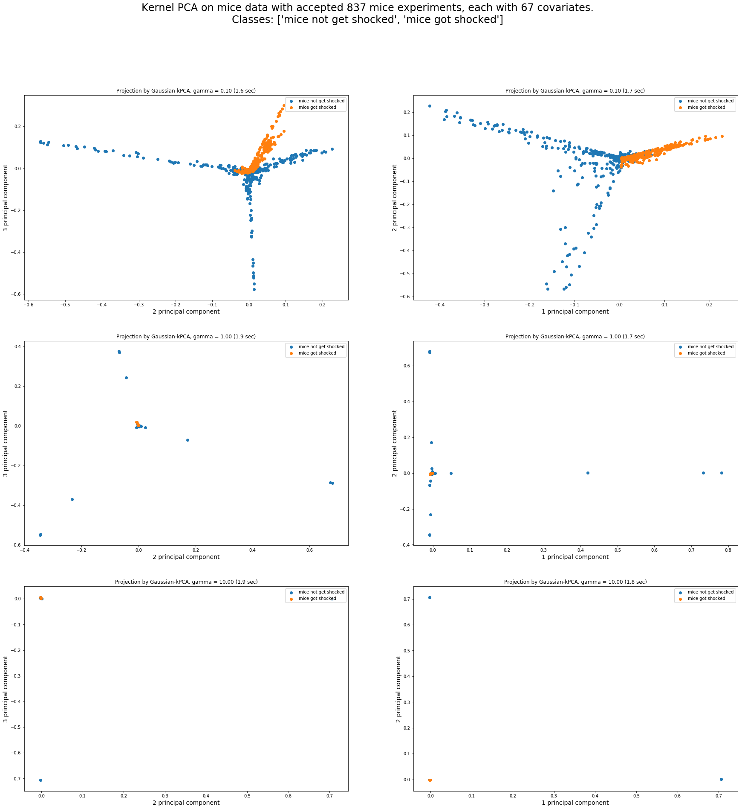

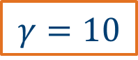
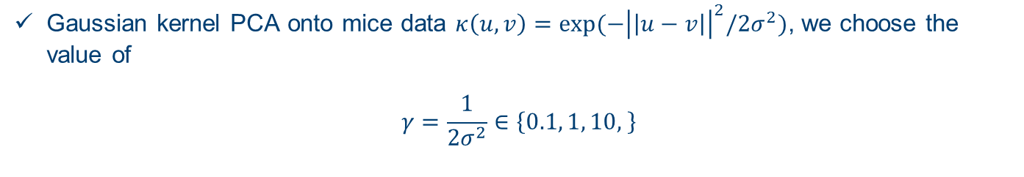
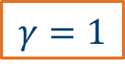
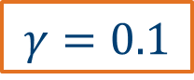
PART IIB: Principal Component Analysis (PCA) onto mice data
Gaussian kernel PCA onto mice data $κ\left(u,v\right)=\exp{(−{\left|\left|u−v\right|\right|}^{2}/2σ^{2})}$, we choose the value of
$$γ=\frac{1}{2σ^{2}}∈\left\{0.1, 1, 10, \right\}$$
$$γ=0.1$$
Disappointed result, doesn’t improve the visualization, because…
$$γ=1$$
$$γ=10$$
Investigation of dimensionality reduction methods for drug discovery data visualization
Notes:
Note that: Higher $γ$, lower $σ^{2}$. More sensitive to the similarity between two points
Kernel PCA sometimes doesn’t improve the visualisation, as the projected space is more difficult to interpret

Slide 21
PART IIB: Implementation of methods on drug discovery data
Familiar with the type of medical data we are analyzing
Drug discovery data
My task of data on the memory of treated Down Syndrome mice (mice data)
Principal Component Analysis (PCA) onto mice data
Definition
Performance onto mice data
t-distributed stochastic neighbor embedding (t-SNE) onto mice data
Definition
Performance onto mice data
Investigation of dimensionality reduction methods for drug discovery data visualization

Slide 22
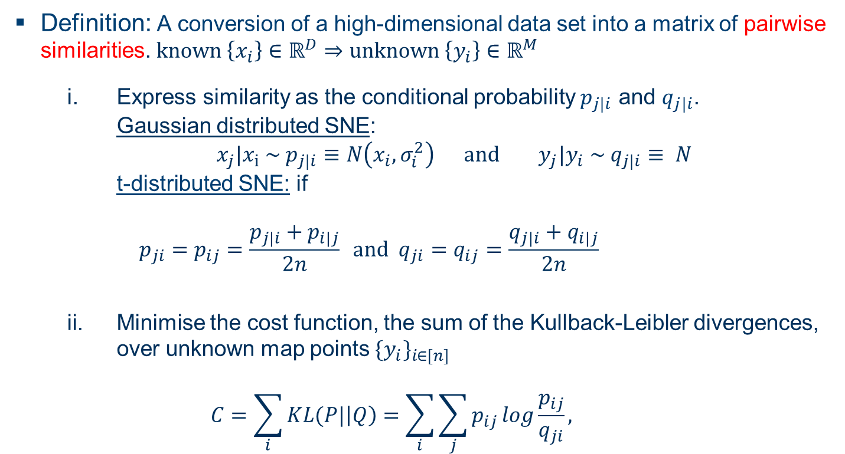
PART IIB: t-distributed stochastic neighbor embedding (t-SNE) onto mice data
Definition: A conversion of a high-dimensional data set into a matrix of pairwise similarities. $known \left\{x_{i}\right\}∈ℝ^{D}⇒unknown \left\{y_{i}\right\}∈ℝ^{M}$
Express similarity as the conditional probability $p_{j|i}$ and $q_{j|i}$. Gaussian distributed SNE: $x_{j}|x_{i} \sim p_{j|i}≡N\left(x_{i}, σ_{i}^{2}\right) and y_{j}|y_{i} \sim q_{j|i}≡ N$ t-distributed SNE: if $p_{ji}=p_{ij}=\frac{p_{j|i}+p_{i|j}}{2n} and q_{ji}=q_{ij}=\frac{q_{j|i}+q_{i|j}}{2n}$
Minimise the cost function, the sum of the Kullback-Leibler divergences, over unknown map points ${{\{y}_{i}\}}_{i∈[n]}$
$$C=\sum_{i}{KL(P|\left|Q\right)=\sum_{i}{\sum_{j}{p_{ij}\log{\frac{p_{ij}}{q_{ji}}}}}},$$
Investigation of dimensionality reduction methods for drug discovery data visualization
Notes:
One type of manifold learning.
SNE starts by converting the high dimensional Euclidean distances between datapoints into conditional probabilities that represent similarities.
The similarity of datapoint x_j to datapoint x_i is the conditional probability

Slide 23
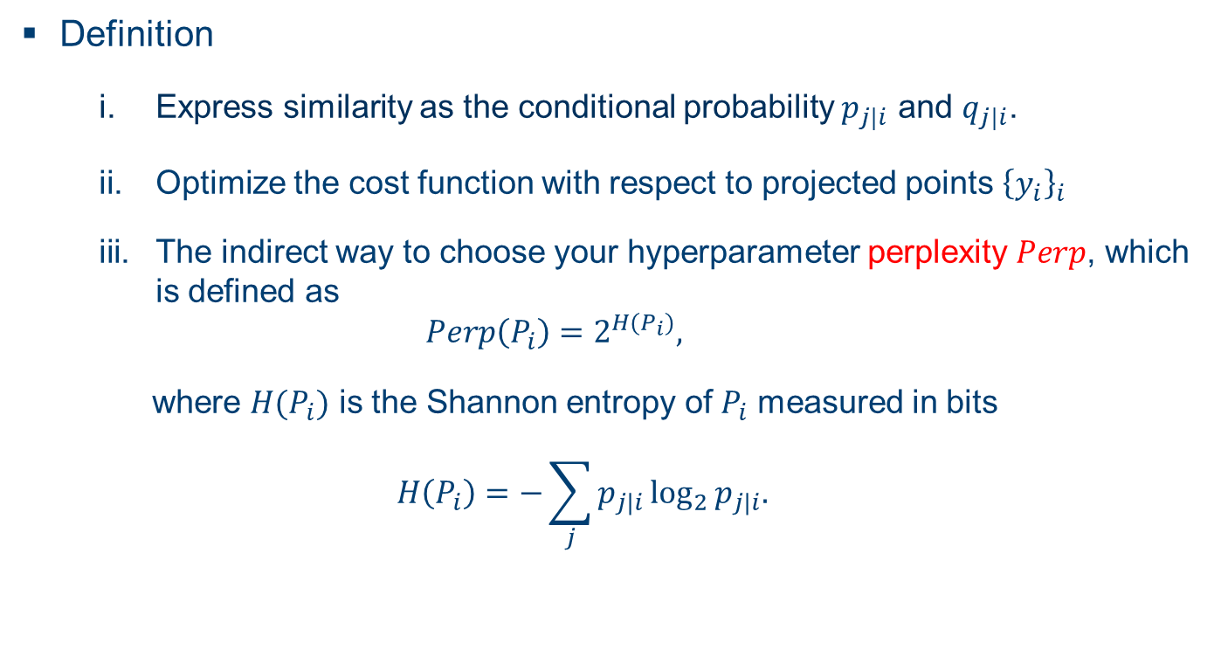
PART IIB: t-distributed stochastic neighbor embedding (t-SNE) onto mice data
Definition
Express similarity as the conditional probability $p_{j|i}$ and $q_{j|i}$.
Optimize the cost function with respect to projected points ${\left\{y_{i}\right\}}_{i}$
The indirect way to choose your hyperparameter perplexity $Perp$, which is defined as $Perp\left(P_{i}\right)=2^{H(P_{i})},$
where $H(P_{i})$ is the Shannon entropy of $P_{i}$ measured in bits
$$H\left(P_{i}\right)=−\sum_{j}{p_{j|i}\log_{2}{p_{j|i}.}}$$
A smooth measure of the effective number of neighbor
Investigation of dimensionality reduction methods for drug discovery data visualization
Notes:
One type of manifold learning.
SNE starts by converting the high dimensional Euclidean distances between datapoints into conditional probabilities that represent similarities.
The similarity of datapoint x_j to datapoint x_i is the conditional probability

Slide 24
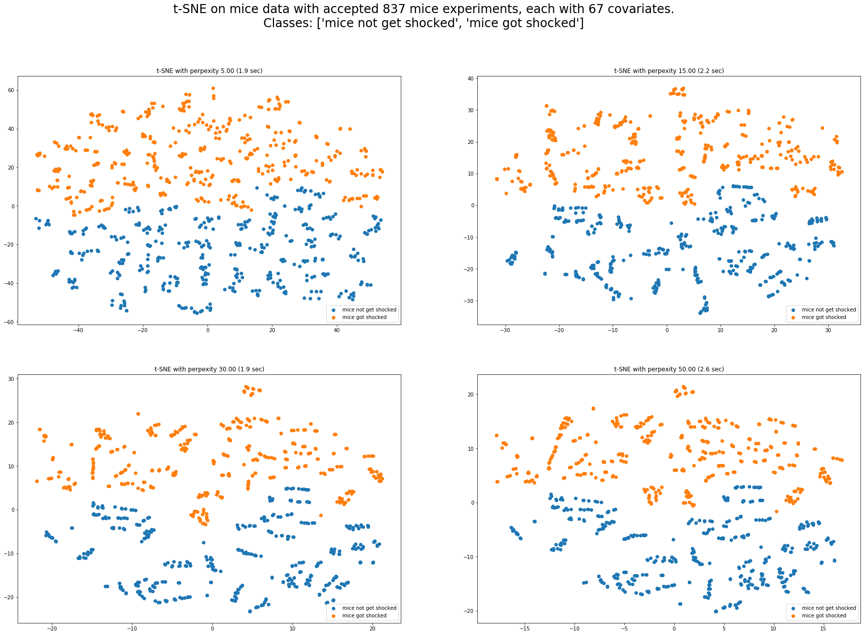
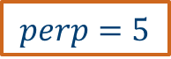
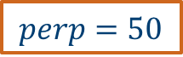
PART IIB: t-distributed stochastic neighbor embedding (t-SNE) onto mice data
Performance onto mice data
Using t-SNE with perplexity $Perp∈\{5, 15, 30, 50\}$
$$perp=5$$
$$perp=50$$
Investigation of dimensionality reduction methods for drug discovery data visualization
Notes:
One type of manifold learning.
SNE starts by converting the high dimensional Euclidean distances between datapoints into conditional probabilities that represent similarities.
The similarity of datapoint x_j to datapoint x_i is the conditional probability

Slide 25
Part IIC: My plan of the rest of my internship
The assumption of methods
Suitable method for your data characteristic: handwritten digit example
Further exploration on mice data
Four classes of mice
A summary table of most of dimensionality reduction methods
A tutorial table
Investigation of dimensionality reduction methods for drug discovery data visualization
Notes:
Emphasis of the table!!!!!!!!!!!!!!!!!!!!!!
This method could be selected on the GSK platform

Slide 26
Part IIC: My plan of the rest of my internship
handwritten digit example
Linear PCA: overall variance
t-SNE: pairwise similarity
Investigation of dimensionality reduction methods for drug discovery data visualization
Notes:
Emphasis of the table!!!!!!!!!!!!!!!!!!!!!!
This method could be selected on the GSK platform

Slide 27
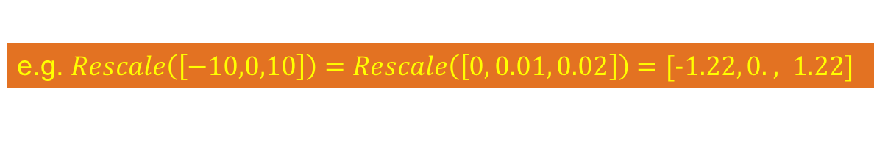
Part IIC: My plan of the rest of my internship
The assumption of methods: PCA example
e.g. $Rescale\left(\left[−10,0,10\right]\right)=Rescale\left(\left[0, 0.01, 0.02\right]\right)=[−1.22, 0. , 1.22]$
Mice dataset without rescaled
Rescaled Mice dataset
Investigation of dimensionality reduction methods for drug discovery data visualization
Notes:
Emphasis of the table!!!!!!!!!!!!!!!!!!!!!!
This method could be selected on the GSK platform

Slide 28
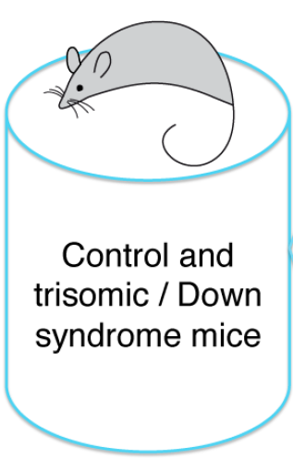
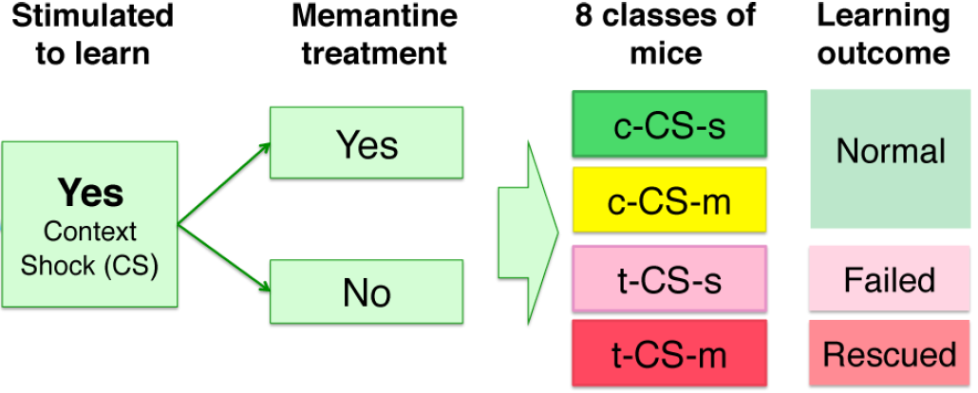
Part IIC: My plan of the rest of my internship
Further exploration on mice data
4
Investigation of dimensionality reduction methods for drug discovery data visualization
Notes:
Emphasis of the table!!!!!!!!!!!!!!!!!!!!!!
This method could be selected on the GSK platform

Slide 29
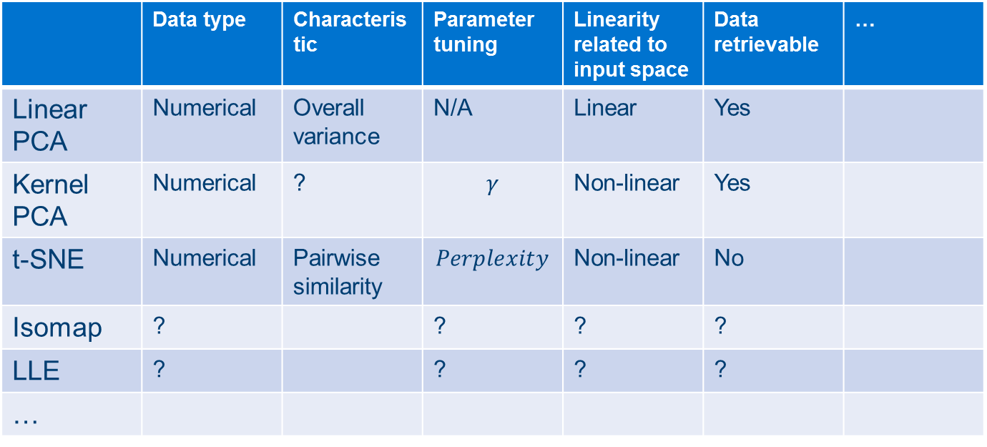
Part IIC: The comparison between methods and summary
A tutorial table of dimensionality reduction methods
 | Data type | Characteristic | Parameter tuning | Linearity related to input space | Data retrievable | …
Linear PCA | Numerical | Overall variance | N/A | Linear | Yes
Kernel PCA | Numerical | ? | $$γ$$ | Non-linear | Yes
t-SNE | Numerical | Pairwise similarity | $$Perplexity$$ | Non-linear | No
Isomap | ? |  | ? | ? | ?
LLE | ? |  | ? | ? | ?
…
Jupiter Notebook, code available for everyone
Investigation of dimensionality reduction methods for drug discovery data visualization
Notes:
Emphasis of the table!!!!!!!!!!!!!!!!!!!!!!
This method could be selected on the GSK platform

Slide 30
PART III: The benefit of such Post Masters Placement Scheme (PMP) to me
Connection to Part III course
more practical application to better understand the theoretical side of method
Modern statistical method: PCA with SVD learned
Know company culture, know people with similar PhD background
Advice my future career and provide their insight of future path to both academia and industry
Investigation of dimensionality reduction methods for drug discovery data visualization
Notes:
Change this slides

Slide 31
THANK YOU FOR YOUR ATTENDENCE
REFERENCE:
Higuera, Clara, Katheleen J. Gardiner, and Krzysztof J. Cios. "Self-organizing feature maps identify proteins critical to learning in a mouse model of down syndrome." PloS one 10.6 (2015): e0129126.
Maaten, Laurens van der, and Geoffrey Hinton. "Visualizing data using t-SNE." Journal of Machine Learning Research 9.Nov (2008): 2579-2605.
Wang, Quan. "Kernel principal component analysis and its applications in face recognition and active shape models." arXiv preprint arXiv:1207.3538 (2012).
Van Der Maaten, Laurens, Eric Postma, and Jaap Van den Herik. "Dimensionality reduction: a comparative." J Mach Learn Res 10 (2009): 66-71.
http://scikit-learn.org/stable/auto_examples/manifold/plot_lle_digits.html
Investigation of dimensionality reduction methods for drug discovery data visualization

